Slide 1
Trabajo Practico N° 12
CATEDRA: PROSPECCION Y EXPLORACION
Cálculo de Reservas

Slide 2
Objetivo del Practico
Dado los datos necesarios para el calculo del volumen de recursos y los parámetros económicos, determinar y clasificar en base al criterio económico los recursos indicados en el modelo de bloques.
La exploración se realizó en un yacimiento vetiforme de Au y Ag, la malla de perforación estaba diseñada en 50x50m.

Slide 3
Estimación de Volumen
Metodos:
Factores Promedio
Bloques Geol y Mineros
Secc transversales (std. Lineal, isolineas)
Triangulos
Polígonos
Programas de Geoestad y mod de bloques √

Slide 4
Análisis Económico
Valor Punto
Leyes de Cabeza
Cotiz Metales
Recup Metalúrgica
Deducc Metalurg
Otros Gastos
Impuestos Export
Transporte
Análisis
Cut Off
Costos de Producción
Mina
Planta
Servicios
Short Term
Costos Operativos
Gastos Comerciales
Gastos Grales & adm
Regalias
Impuestos Bancarios
Deprec & Amortiz
Exploración
Costos Financieros

Slide 5
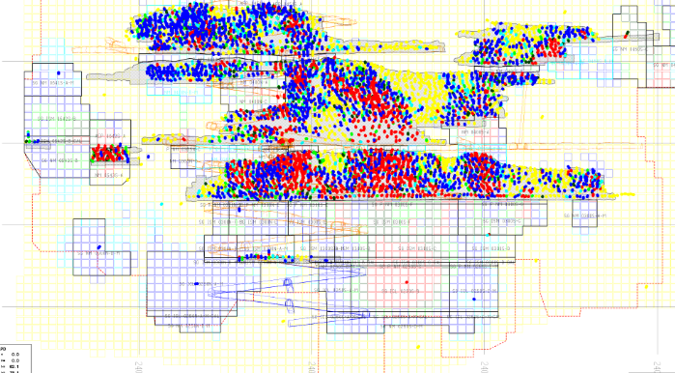
Ejemplo Real

Slide 6
JORC Code Join Ore Reserves Comitee
Transparency requires that the reader of a Public Report is provided with sufficient informa-tion, the presentation of which is clear and unambiguous, to understand the report and not be misled by this information or by omission of material information that is known to the Competent Person.
Materiality requires that a Public Report contains all the relevant information that investors and their professional advisers would reasonably require, and reasonably expect to find in the report, for the purpose of making a reasoned and balanced judgement regarding the Exploration Results, Mineral Resources or Ore Reserves being reported. Where relevant information is not supplied an explanation must be provided to justify its exclusion.
Competence requires that the Public Report be based on work that is the responsibility of suitably qualified and experienced persons who are subject to an enforceable professional code of ethics (the Competent Person).

Slide 7
JORC Code

