Slide 1
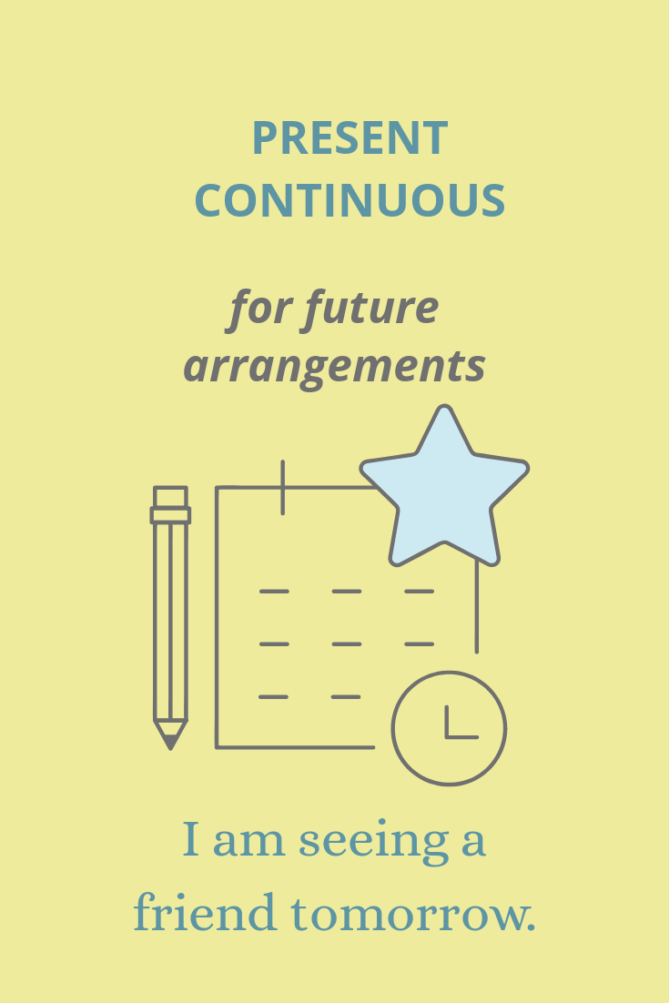

Slide 2
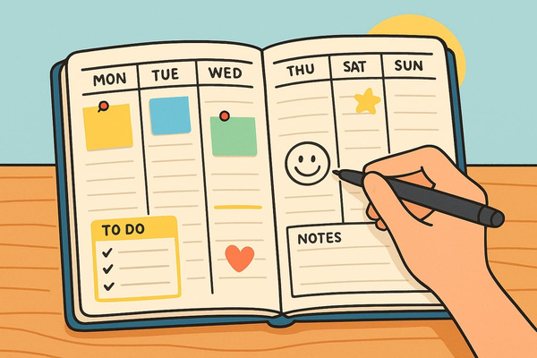
Podemos usar el presente continuo para hablar de actividades planeadas de antemano.
  We are having an English exam next week.
  I’m seeing the doctor this afternoon.
  She’s attending a training course next Friday.
  What are you doing at the weekend?
  He’s not coming in tomorrow because he has a day off.
🤔
Este uso del presente continuo es muy simple: es usar este tiempo verbal acompañado de una expresión de tiempo futuro: this afternoon, tomorrow, next Monday.

Slide 3

TEST

